Slide 1
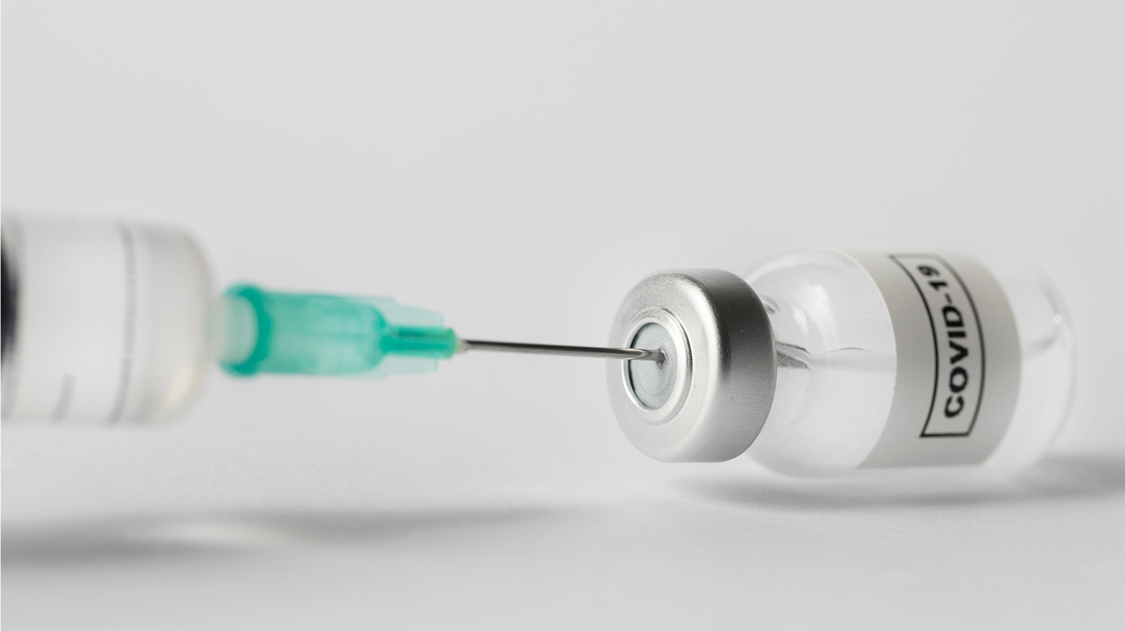
COVID-19 Vaccination Project
By: Eduardo Robles
Paul Tuck
Gemma Miranda

Slide 2
Table of Content
General Information
Project
Data Sources
Statistics
Time Series
Conclusion
Questions

Slide 3
General Information
What is COVID-19? Coronavirus disease (COVID-19) is an infectious disease caused by the SARS-CoV-2 virus.
How COVID-19 Spreads?
The virus spreads mainly from person to person:
Between people who are in close contact with one another (within about 6 feet).
Through respiratory droplets produced when an infected person coughs or sneezes.
These droplets can land in the mouths or noses of people who are nearby or possibly be inhaled into the lungs.
COVID‑19 may be spread by people who are not showing any symptoms.
The virus may also be spread through surfaces:
By a person touching a surface or object that has virus on it and then touching their own mouth, nose, or possibly their eyes.

Slide 4
Project
The purpose of this project is to identify countries that are struggling to vaccinate their people against COVID-19.

Slide 5
DATA SOURCES
KAGGLE

Slide 6
STATISTICS

Slide 7
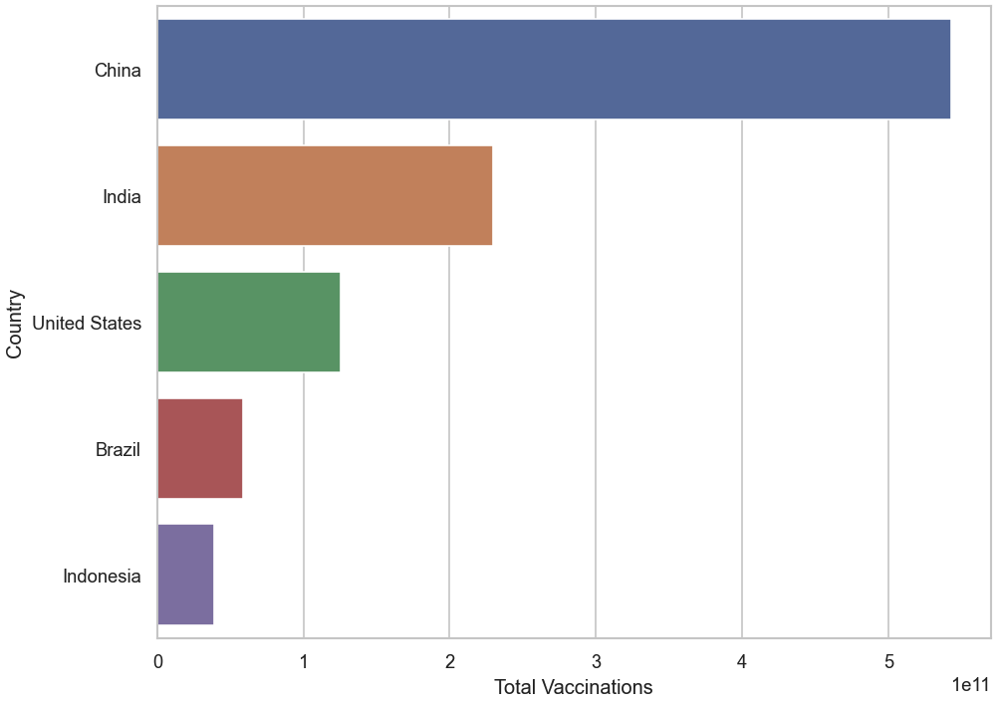
Statistics - Most Vaccinations

Slide 8
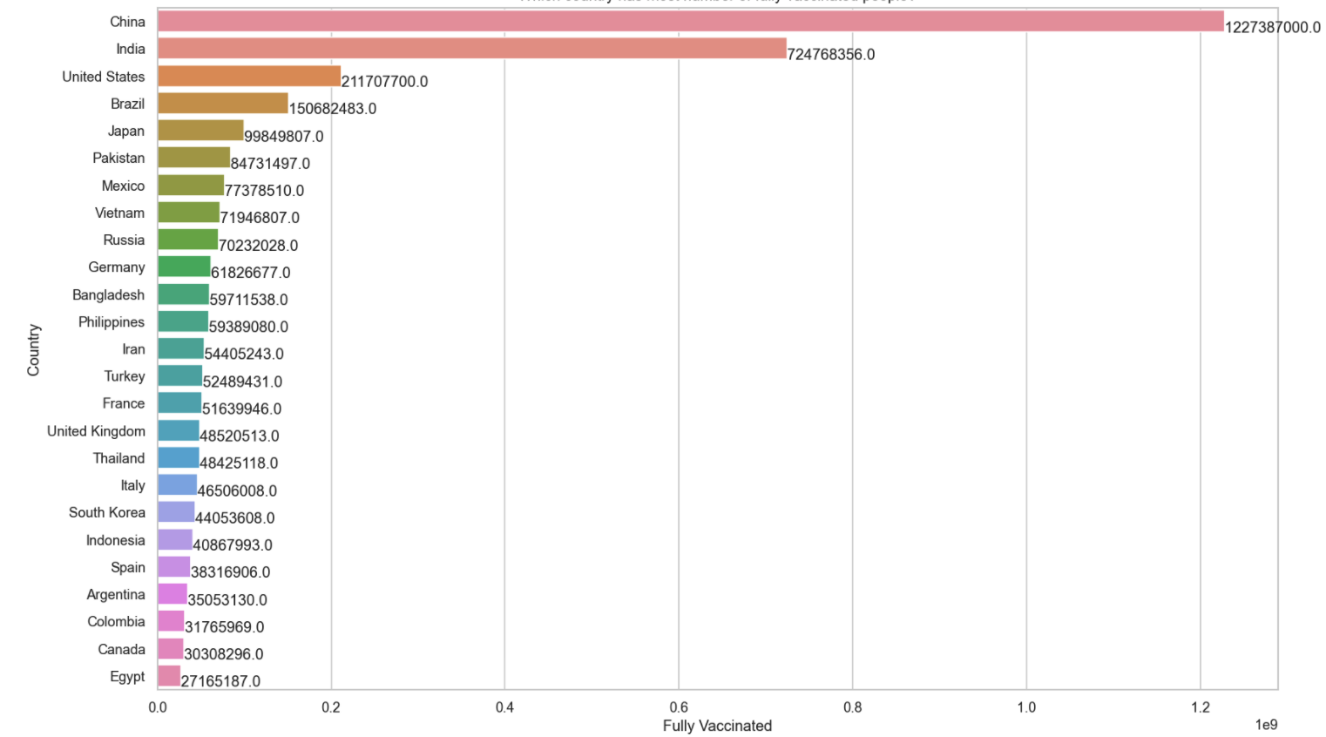
Statistics – Fully Vaccinated

Slide 9
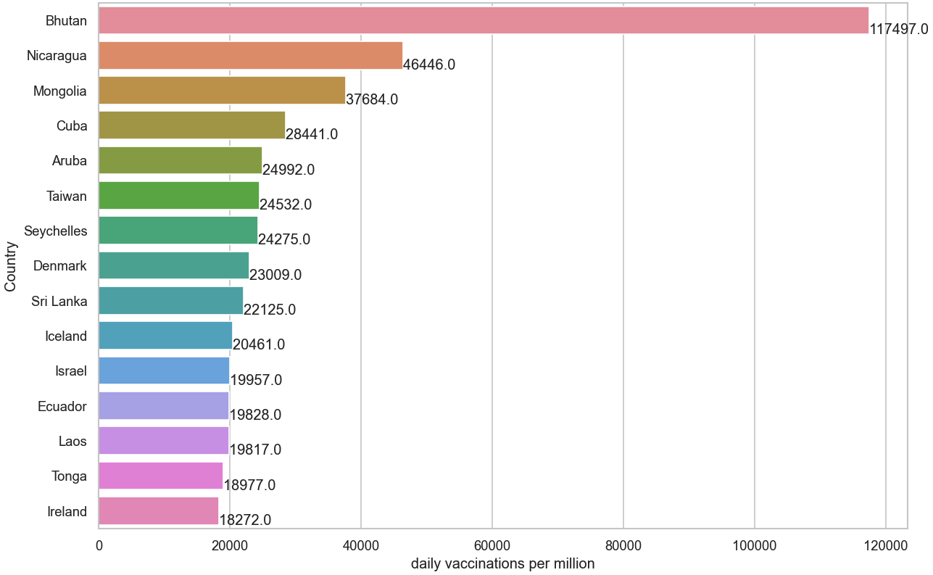
Statistics – Daily Vaccinations

Slide 10
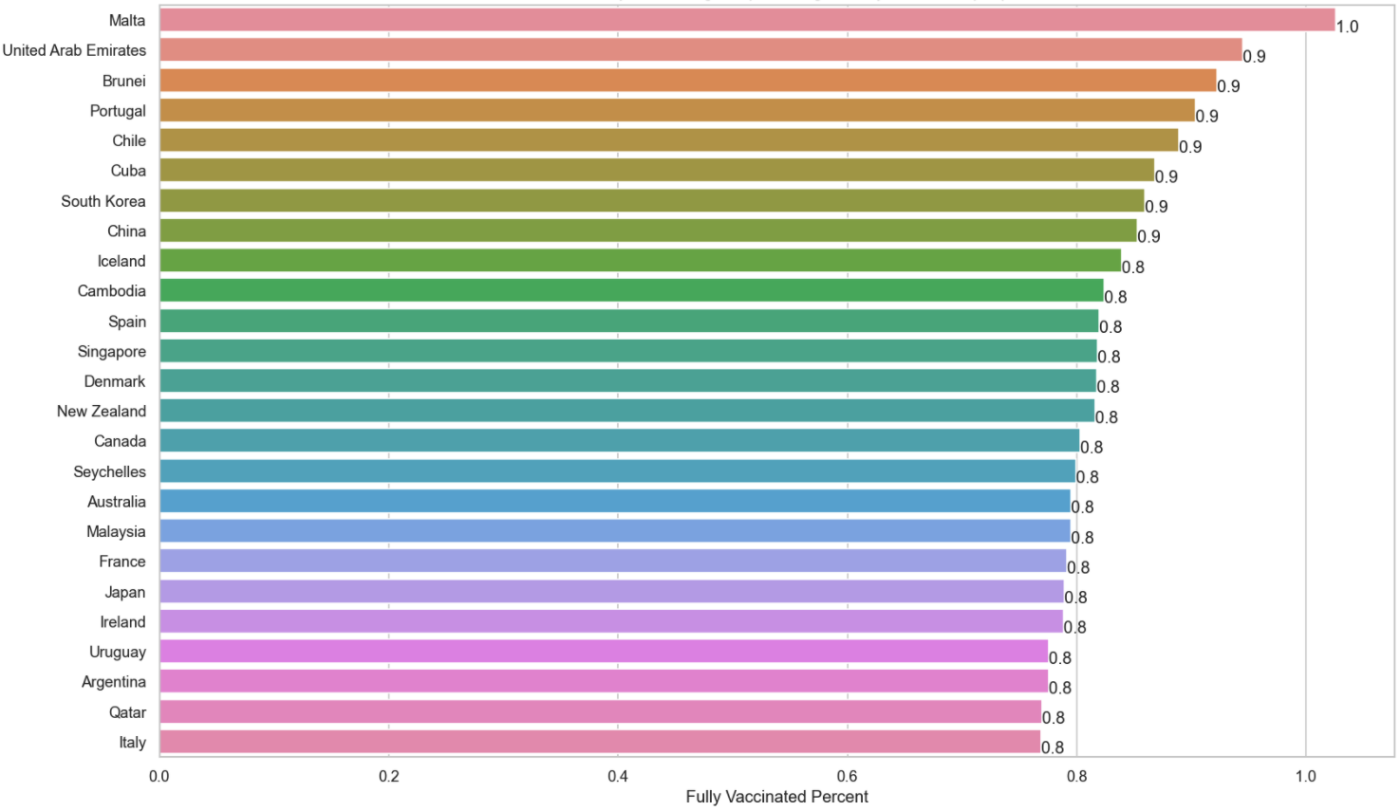
Statistics – Fully Vaccinated

Slide 11
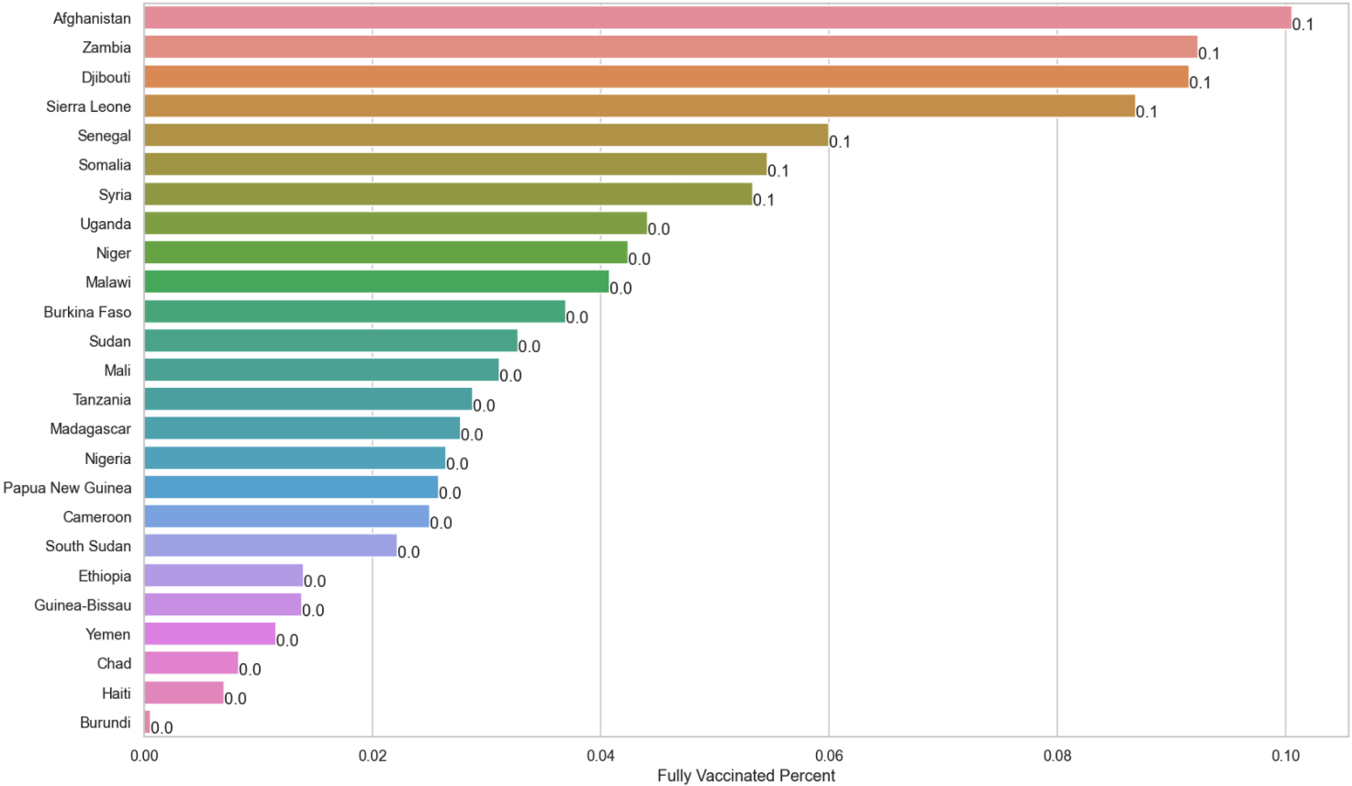
Statistics – Fully Vaccinated (less than 10%)

Slide 12
TIME SERIES

Slide 13
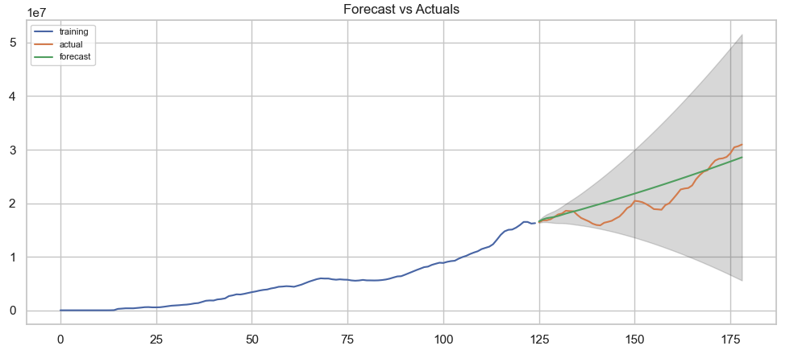
Time Series

Slide 14
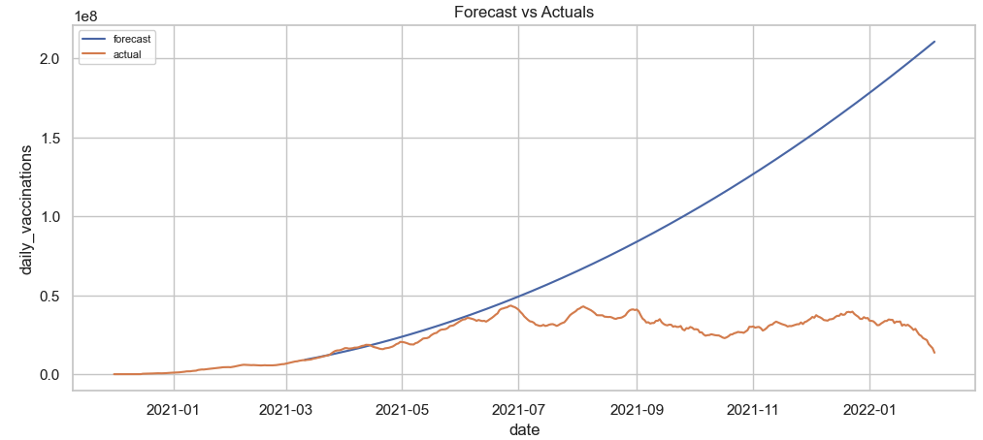
Time Series

Slide 15
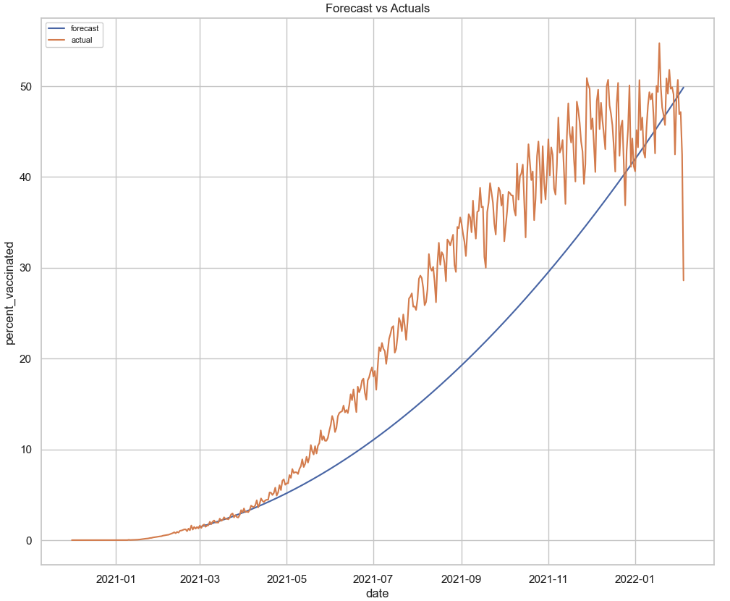
Time Series

Slide 16
CONCLUSION
Text

Slide 17
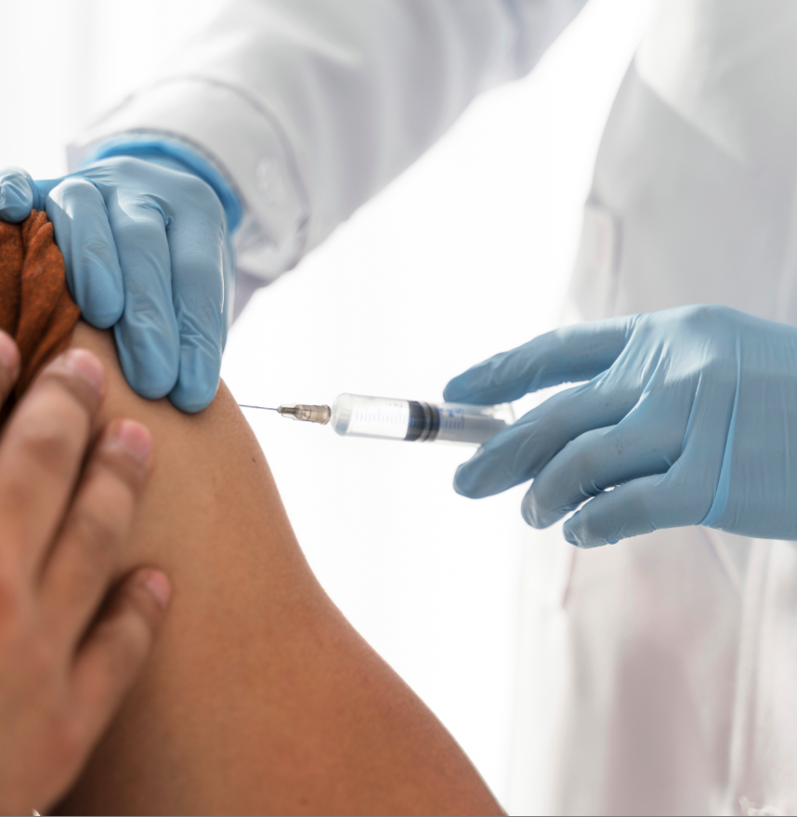
Questions

